Slide 1

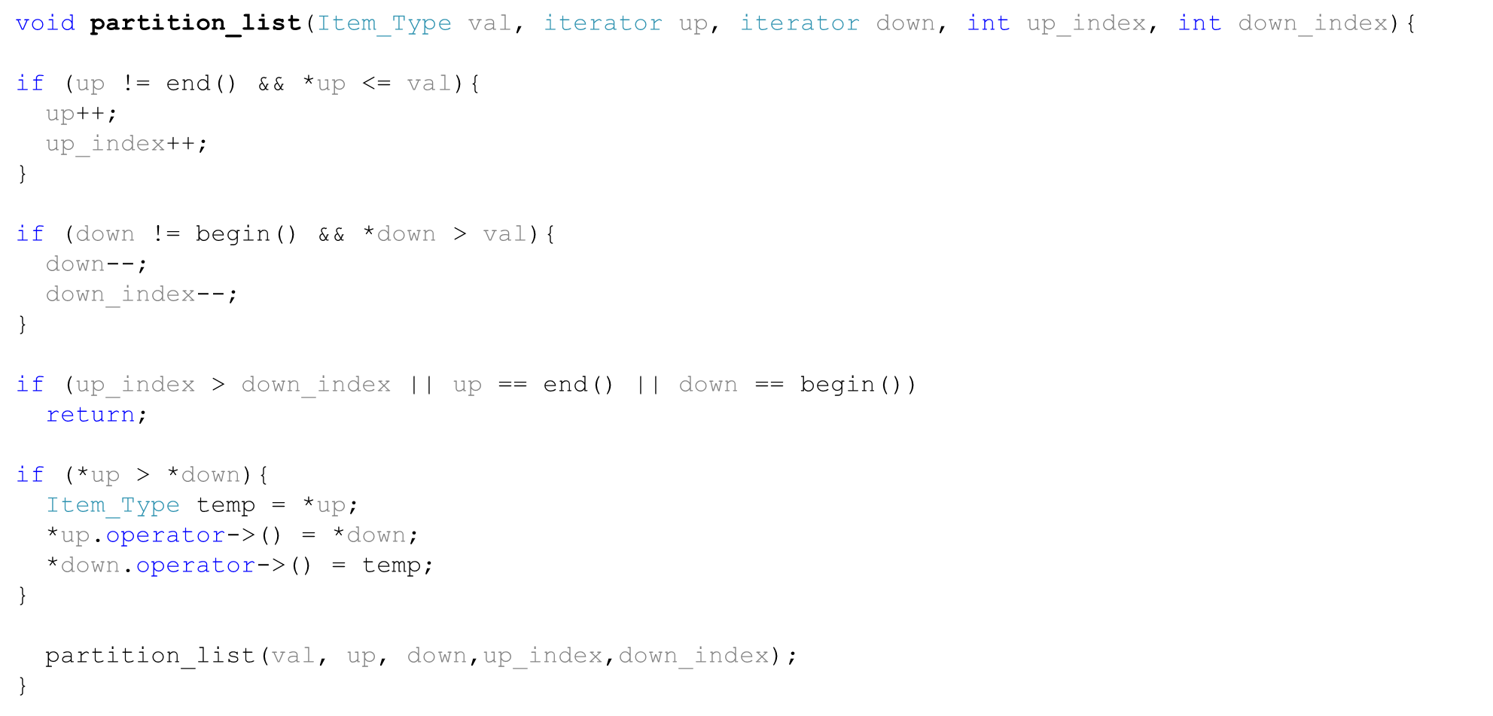
Partitioning a List (1)

Slide 2
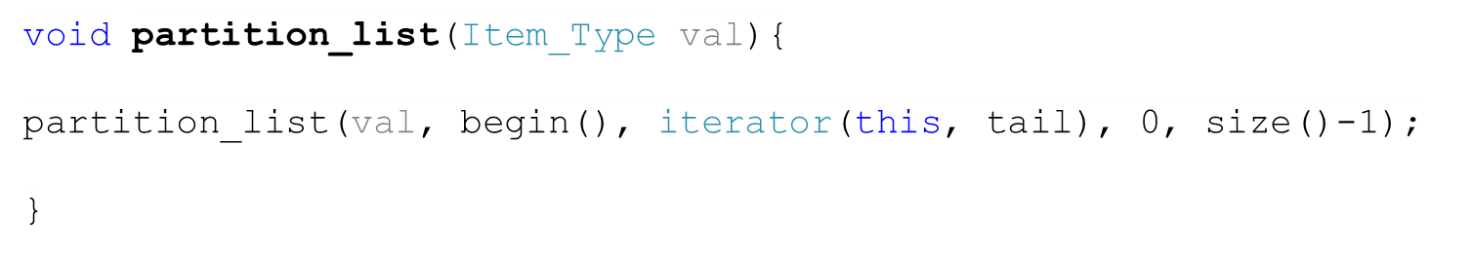
Partitioning a List (2)

Slide 3
Call Center Problem (1)
A company allows customers to call to report problems or ask for clarifications, etc. There are many employees that work in the center to respond to calls from customers. When a customer calls, she has to wait until the next employee is available to talk to her. However, there are two types of customers the company supports: A regular customer that uses basic services, and a premium customer that uses advanced services. The call center prioritizes the premium customers over the regular customers.
For every two premium customers that are served, one regular customer is served.
What data structure would you use to model the waiting of customers? Why?
Write pseudo-code algorithms for the call (join line), and serve customer functions.

Slide 4
Call Center Problem (2)
CallCenter
1
1
2
2
Queue
<Customer>
Customer
1
*
List<Employee>
1
*
Employee

Slide 5
Call Center Problem (3)
We will use queues to model waiting lines of customers. It makes sense to serve customers that have been waiting the longest first.
We will use two queues for each type of customer. premium_queue and regular_queue
We will use two lists to keep track of employees, available/unavailable employees.

Slide 6

Serve_customer (Main)
void serve_customer(){
Customer cust;
if((!premium_customer.queue.empty()) && (premium_served_since_regular <2 || regular_customer_queue.empty())) {
cust= premium_customer_queue.top();
premium_customer_queue.pop();
num_premium_customers_served++;
premium_served_since_regular++;
Serve(customer);
}
else if(!regular_customer.queue.empty()){
cust= regular_customer_queue.top();
regular_customer_queue.pop();
num_regular_customers_served++;
premium_served_since_regular=0;
Serve(customer);
}throw Exeption(“there is no customer to serve at present time”); return cust;}

Slide 7
join_line (CallCenter)
void join_line(Customer customer){
switch(customer.Type) {
case cType.Regular:
regular_customer.queue.push(customer);
break;
case cType.Premium:
premim_customer.queue.push(customer);
}

Slide 8
serve
void serve (customer){
if(!available_employees.empty()){
Employee emp=available_employees.front(); //assuming there is a list for available employees and another for unavailable employees
available_employees.pop_front();
unavailable_employees.push_back(emp);
emp.serve(customer); //this will push the employee back to the available employees when the service is done
}
}

